Slide 1
Health and Work Week 6 The Aging Workforce

Slide 2

Directed study week 5

Slide 3
Directed Study
Read van der Molen et al (2004), ‘World at work: Bricklayers and bricklayers’ assistants’, Occupational and Environmental Medicine, 61, pp. 89-93. Available at: https://oem.bmj.com/content/61/1/89 (accessed: 24 October, 2018)
Visit the No Time To Lose Website: https://www.notimetolose.org.uk/
Find out about one occupational cancer and think about what needs to be done to protect employees and prevent cancer of this type. What health education messages should be given to employees?

Slide 4
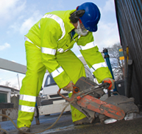
Construction Industry
Hazardous substances
Construction dust
Cement
Lead
Solvents
Isocyanates
Micro-organisms
Carbon Monoxide
Carcinogens e.g. asbestos and silica, diesel emissions
Physical Health Risks
Noise
Vibration
Manual Handling
Repetitive Work
Working at Height
Working outside – UV exposure through solar radiation

Slide 5
Construction Other Issues
Male Dominated Industry - culture
Men’s Health Issues
Access to GP and health checks
Access to treatment
Protective Equipment
High Suicide Risk
Overweight and Obesity
Insect Bites
Access to healthy diet
Migrant workers
Hygiene needs and safe places to eat
VIDEO: SUN SAFTY IN CONSTRUCTION: https://youtu.be/i1vEuLdOgnw

Slide 6
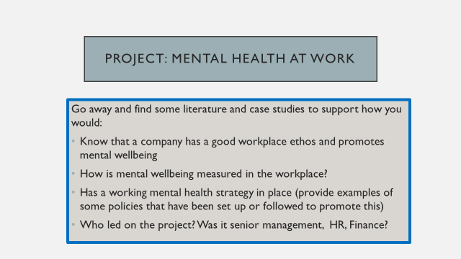
Directed Study week 6 – Did you find any case studies?

Slide 7
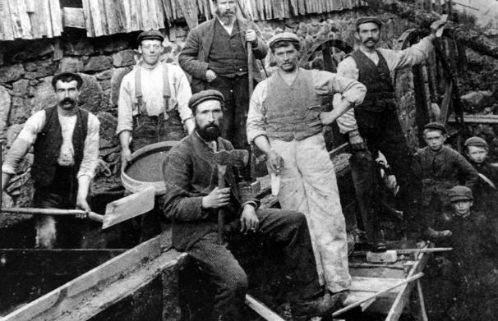
The Aging Workforce

Slide 8
What does an older worker look like?

Slide 9
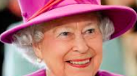

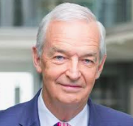
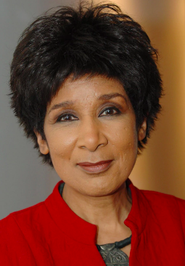
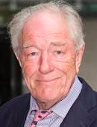

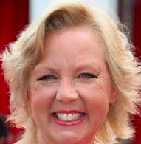

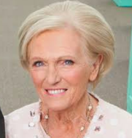

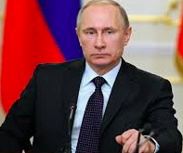

92
68
71
65
78
64
59
72
66
69
83
74

Slide 10
What is aging?

Slide 11
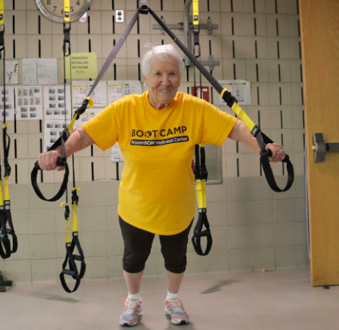
What is aging?
Chronological age – time lived already or time left to live
Biological process linked to cell deterioration, fertility and mortality
Cognition and function:
A state of mind
Expectation
Identity
Maturity and independence
Also see: Sanderson, W.C. and Sherbov, S. (2015) ‘Faster increases in human life expectancy could lead to slower population aging’, PLOS ONE, 10(4): e0121922.https://doi.org/10.1371/journal.pone.0121922

Slide 12
Can an older person do a job as well as a younger person?

Slide 13
Six negative stereotypes
Less motivated
Generally less willing to participate in training and career development
More resistant and less willing to change
Less trusting
Less healthy
More vulnerable to work-family imbalance
Ng, T. W.H and Feldman, D.C (2012) ‘Evaluating six common stereotypes about older workers with meta-analytical data’, Personnel Psychology, 65, pp.821-858, https://doi.org/10.1111/peps.12003

Slide 14

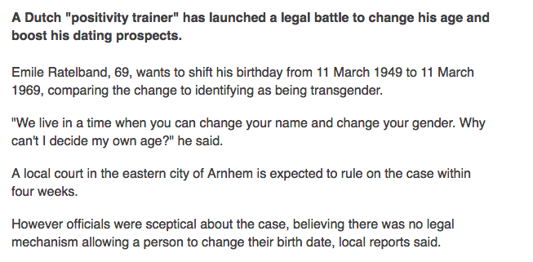

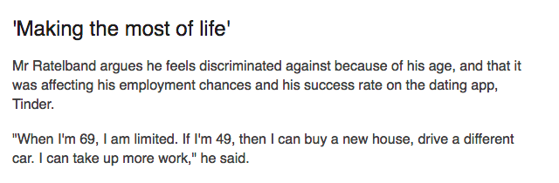
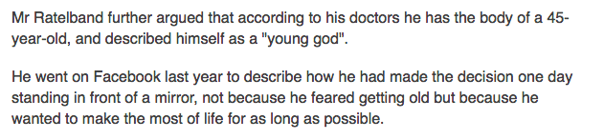
https://www.bbc.co.uk/news/world-europe-46133262

Slide 15


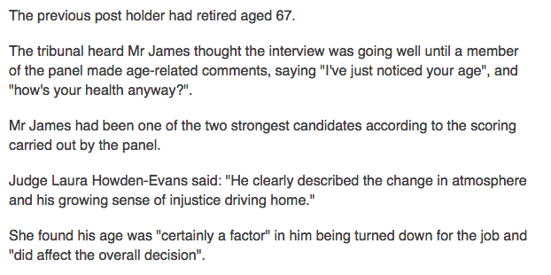
https://www.bbc.co.uk/news/uk-wales-45875475

Slide 16
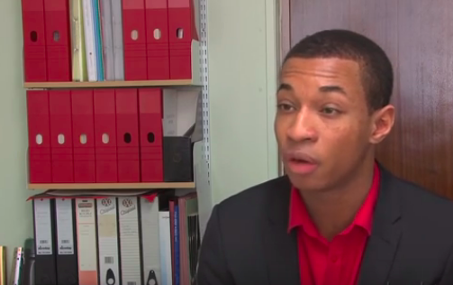
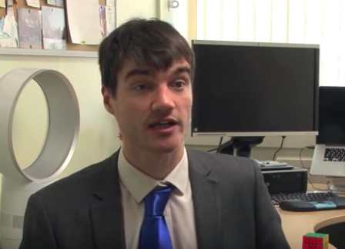
Working Late Project [Bb]
Luke’s Story: https://youtu.be/V4ixR0OoZRk

Slide 17
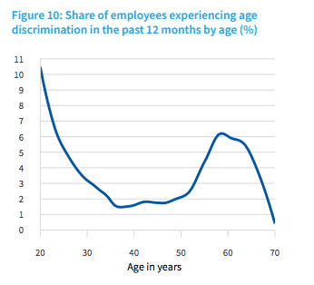
Age discrimination
Eurofound (2017), Working conditions of workers of different ages: European Working Conditions Survey 2015
Luxembourg: Publications Office of the European Union. p29 [Bb]

Slide 18
Age Discrimination at the Workplace
The Equality Act - no one can or should be treated unfairly or denied any type of opportunity only because they are above or below a certain age or they belong to a certain age group.
In the workplace this means they cannot be denied a job, training or promotion simply because of age.
Discriminating against an employee or prospective employee only because they are ‘too old’ or ‘too young’ is against the Act and considered to be illegal.

Slide 19
Discrimination
Direct discrimination – denied promotion because of being ‘too old’ or being denied a raise because of being ‘too young’
Indirect discrimination – If a training course is offered only to recent younger graduates, it could constitute indirect discrimination, as it does not allow older employees to avail of the opportunity.
Harassment – Offensive jokes or comments about age or the age of someone you associate with, such as a partner, could amount to harassment, which is a form of age discrimination.

Slide 20
The Act and Age Discrimination (overview)
It is unlawful to be refused a job because of being too young or too old (there are some legal caveats).
Employment terms and conditions must remain the same for all employees irrespective of their age.
It is against the law for any type of training provider to lay down upper or lower age limits for training, unless the need to do so can be objectively justified.
In any workplace, the policies regarding promotions and transfers are applicable equally to all employees, irrespective of age
Redundancy or dismissal should not discriminate on the grounds of age
Prior to 2011 there was compulsory retirement age. Now there is not. The retirement age is when an employee chooses to retire. However, the employer can discuss retirement if you are not performing at the required standard and you have access to a pension.

Slide 21
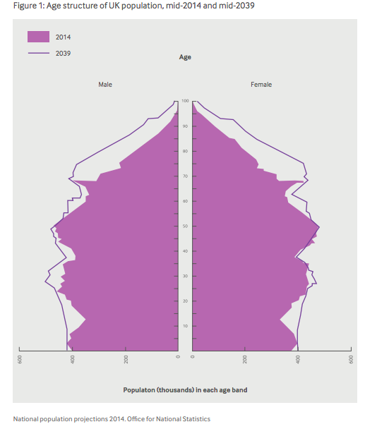
Older people in workplaces
There are now over 10 million workers in the UK over the age of 50 (ONS, 2018)
By 2020 one third of workers will be over 50 (Houses of Parliament, 2011).
Nicholson, P., Mayho, G., Robson, S. and Sharp, C. (2016) Aging and the workplace: A report from the BMA Occupational Medicine Committee.London: BMA. Available at: https://www.bma.org.uk/advice/employment/occupational-health/ageing-and-the-workplace (accessed 11 November 2018)

Slide 22
Older People in Workplaces
There may be:
Deterioration of visual acuity and functioning in low light levels may begin in the mid 40s.
Hearing loss is common in those over 60, making conversations and instructions harder to distinguish from background noise.
Aerobic and cardiovascular functions decline with age, and recovery time following exertion increases.
Musculoskeletal changes lead to reductions in muscle and grip strength, posture and balance.
Houses of Parliament (2011) ‘An aging workforce’, PostNote, 391. Available at: https://www.parliament.uk/pagefiles/504/postpn391_Ageing-Workforce.pdf (accessed 11 November 2018) [Bb]

Slide 23
BUT...
The evidence for these arguments comes from older data, where many people had different workplace exposures.
Cumulative and multiple exposures may exacerbate existing ill health or contribute to hearing loss, musculoskeletal pain etc.
Relates to reversible factors that can be adjusted with adaptions to work and lifestyle adjustments.
Does not recognise wider social factors as influencing health rather than age alone.
Generalised data

Slide 24
Although...
The prevalence of long standing illness or disability increases with age:
one in five 16-44 year olds (approx)
a third of 45-64 year olds (approx)
one half of 65-74 year olds (approx)
Among people of working age around 60% of those who have long-term conditions and 46% of those who are disabled are in employment.
Multi-morbidity is the norm for people with chronic disease, and although its prevalence increases with age, more than half of all people with multi-morbidity are younger than 65 years.
The most socioeconomically deprived young and middle-aged people have substantially more multi-morbidity than do their most affluent peers
However: long-term conditions need not prevent people from working, or affect their performance at work.
See Nicholson et al., (2016) p11

Slide 25

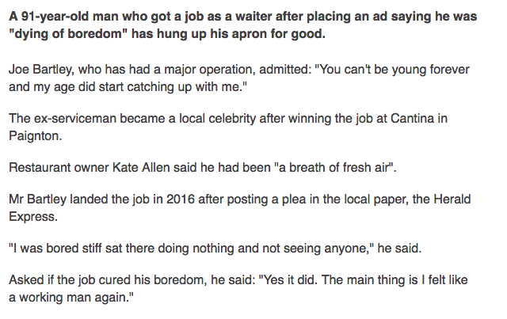
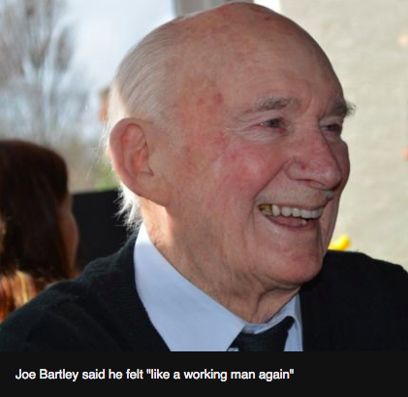
https://www.bbc.co.uk/news/uk-england-devon-43434767

Slide 26
What does an older person bring to the job?

Slide 27
The contribution of older workers
Research shows that there is no difference in their productivity
DWP (2013) report the benefits of employing
older workers as part of a multi-generational workforce include:
a broader range of skills and experience;
opportunities for mentoring new recruits;
transfer of skills across the workforce;
reduced staff turnover; and
improved staff morale.
DWP (2013) Employing older workers, London: Crown

Slide 28
Design a Programme to Promote Health for employees to Age Well at Work

Slide 29
Health Promotion across the working life-course for Healthy Aging (Tristi’s List)
Promotion of Intergenerational Learning
Active lifestyle at work avoiding sedentary practices
Healthy Eating
Strengthening exercises/resistance training
Encouraging employees to have regular check ups e.g. health checks, eye tests, cholesterol etc.
Promote recovery between shifts
Break down stigma and discrimination – age positive culture
Promote Active Aging (see next slide)
Develop positive psychosocial environment
Development of sense of personal competence and skills acquisition
Organise work environment activities to be adaptable to individual needs and capabilities (flexibility)
Ensure that work place does not contribute to ill health
Ensure that job design does not adversely affect health
Support all employees to plan ahead from mid-life, including career and personal goals, relationships and caring responsibilities, wellbeing, health and finance.
Apply all measures to all employees as chronological aging is inevitable!

Slide 30
Active Aging and Healthy Aging
Active Aging“… the process of optimizing opportunities for health, participation, and security in order to enhance quality of life as people age.” (WHO, 2002)
WHO Healthy Aging Strategy 2015-2030:
Healthy Aging is “...the process of developing and maintaining the functional ability that enables wellbeing in older age”. Functional ability is about having the capabilities that enable all people to be and do what they have reason to value.”
See: http://www.who.int/ageing/healthy-ageing/en/
WHO (2002) Active Aging: A Policy Framework, Geneva: WHO

Slide 31
Active Age Management (Ilmarinen,2012)
The eight targets of active age management are:
Better awareness about ageing
Fair attitudes towards ageing
Age Management as a core task and duty of managers and supervisors
Age Management included in HR policy,
Promotion of work ability and productivity
Lifelong learning
Age-friendly work arrangements, and
Safe and dignified transition to retirement.

Slide 32
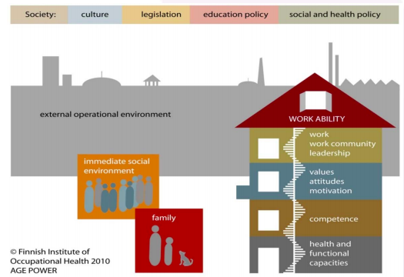
Workability
Ilmarinen, J. (2012) Promoting active aging in the workplace. Bilbao: European Agency for Health and Safety, Available at: http://www.ipbscordoba.es/uploads/Documentos/promoting-active-ageing-in-the-workplace.pdf (accessed 11 November 2018)

Slide 33
Directed Study
1. What models and theories can you draw upon to support your approach to health promotion across working life?
2. What are the challenges that a workplace health promoter might face in delivering change?

